Slide 1

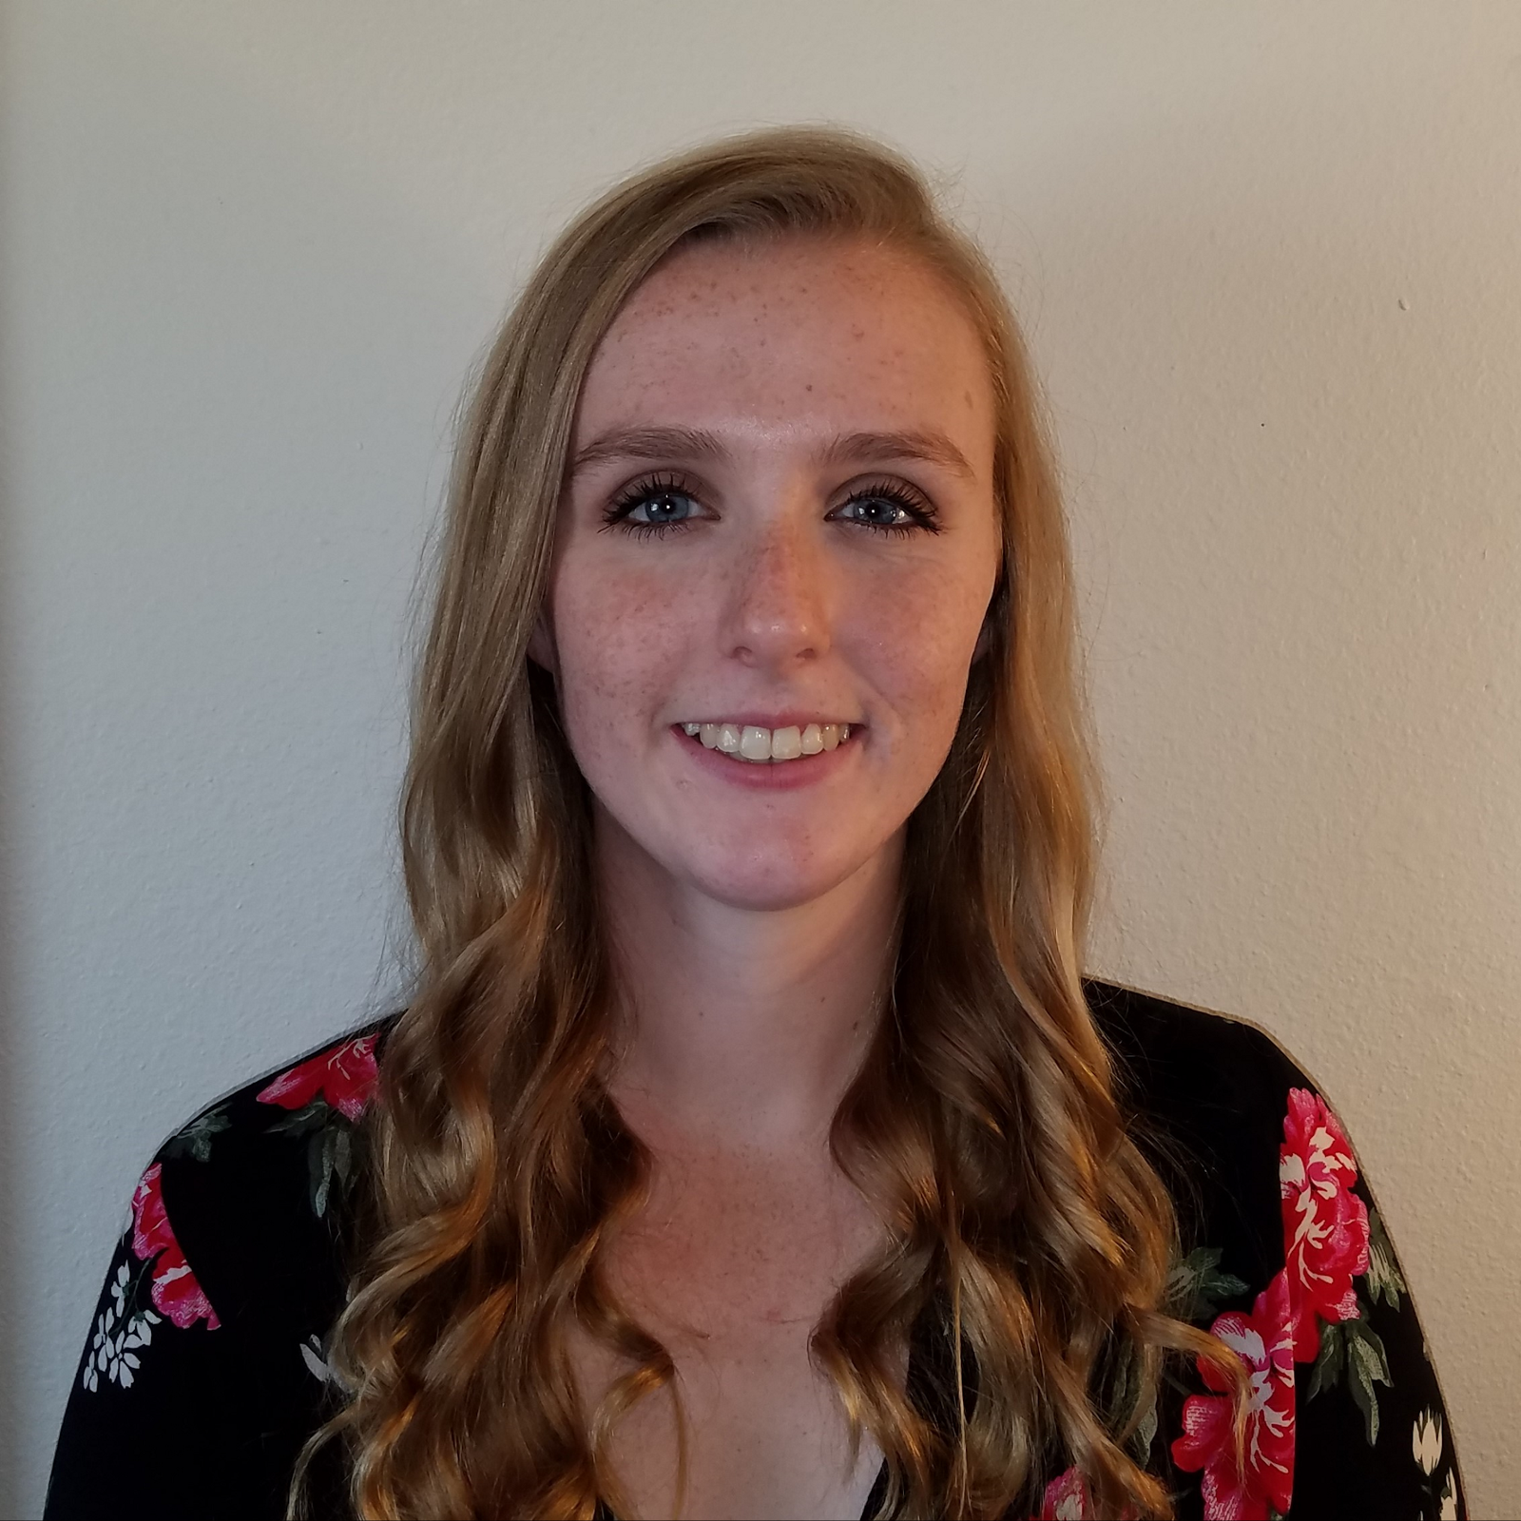

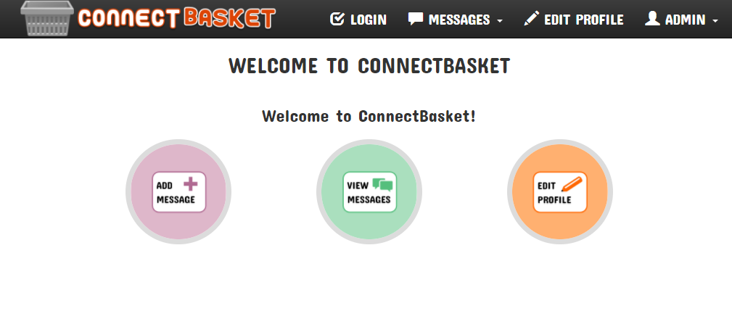
###
Connectbasket
Introduction and background
Software to help improve pet care at the OSU Veterinary Hospital by streamlining internal hospital communication
Having an efficient and easy-to-use software system for managing operations is integral for any company, and the Oregon State University Veterinary Hospital is no exception. The current software used by the hospital to manage their daily operations is decades old and doesn’t allow efficient communication within the hospital. This software causes many unnecessary errors and patient and owner suffering that could be avoided with a better system. The hospital needs a new software package that will not only provide a system that doesn’t hinder workflow, but will improve it and allow for increased efficiency.
Henry Fowler, Kailyn Hellwege, Taylor Kirkpatrick
REsults
Project goals
Loribus eum labo. Essit ipsundunt volore arupid qui isquunt as doles ipsunt.
Hicid modit ex estinienit et audae usted est qui occullorio molupit vollaut volumpt molorestio blaborionet elictem est, ius accatiur sam eum lamus doloresti ipsam inverum utecum iustia doluptur, que nimi ncima nimus est ut latium qui nempore odisqui cuptae occus que opta dis non sequi autemque most, vent ullam asit modite lab ipsamusant.
Ut volore secuptio es rem rerati volor atem lic te voloria qui simporest doluptat etur? Alignit volorae venimai onsequame odipitatur sequosa ntiste ea id que ipsam, omniaed et offictus moluptiis et ius.
Qui archili busdae exere quias essum fugiand itisquo occulla utendi autaquo doluptu stotate pre poris diciumqui officipsapic to modi quos eum rem sit quasse accatur?
Obis erit erianti debit, odi consequate dolupta epudit et etur rempore. Lam ariae aperit, officatio eos quia sandaectae. Ut aribuscimpor moloris non..
odipsae id quaepe que doluptas et placcullias peditaturis dolorem et recusda ntiberum eos imi quaeperro ea ipiet est.
Allow users to create a message which will be associated with a patient and corresponding owner
Allow messages to have a status to tell whether they are open or closed
Allow messages to be routed to other users or groups of users
Allow notes to be added to messages
Allow users to have profiles where they can select or change their group membership
Provide an audit log of all messages created over a given time period
Increase the overall efficiency of messages being transported throughout the hospital
Reduce the amount of paper being printed
Reduce errors in the communication process of the hospital
Project description
Project outcomes
Allow users to create a message which will be associated with a patient and an owner of that patient
Allow messages to have a status to tell whether they are open or closed
Allow messages to be routed to other users or groups of users
Allow notes to be added to messages
Allow users to select a group or groups to be a part of
Provide an audit log of all messages created over a given time period
Increase the overall efficiency of messages being transported throughout the hospital
Reduce errors in the communication process of the hospital
Bullet. lum exer adipsustrud doloree tuerat lorpera esenibh eu faccum eum iuscili quamcommy nit lorerillut ullam quat lore verostrud ming faciliquisse modolortin volore
Vel et vel dionsenit adit, consenim zzrillute el euguerostie faci bla conse ad essi. Vel et vel dionsenit adit, consenim zzrillute el euguerostie faci bla conse dolore tet, volobor si.
Lore del utatis amcorpercin henim riliq uismodo leniat aciduisl il eugait velis nos alit prat ad tions et vel euguerostie dolore tet, volobor si.
Sim ipsum dolorem velis aut vulputpat eu facilit am delestrud eui blan vendre elisisc illaorp ercilisi blan eu amconsequat, senisi.

